Slide 1
Building the Future for Mississippi’s Children on a Foundation of Equity Junious Williams, JD Senior Advisor Collective Impact Forum
MISSISSIPPI’S
FORUM FOR THE FUTURE

Slide 2
Overview
a) What is Equity? and b) What are some important related concepts?
Why is Equity important to the nation?
Why is Equity important in early childhood health and learning?
What are some tools/advice for discussing, developing and implementing Equity plans?
What are some resources for exploring Equity further?

Slide 3
a) What is Equity?

Slide 4
Definitions of Equity
PolicyLink Definition
Equity is just and fair inclusion into a society in which all can participate, prosper, and reach their full potential.
Equity Manifesto
Urban Strategies Council Definition
Equity is fairness and justice achieved through systematically assessing disparities in opportunities and outcomes and redressing disparities through targeted actions.
http://www.urbanstrategies.org/equity/equitydocument.php

Slide 5
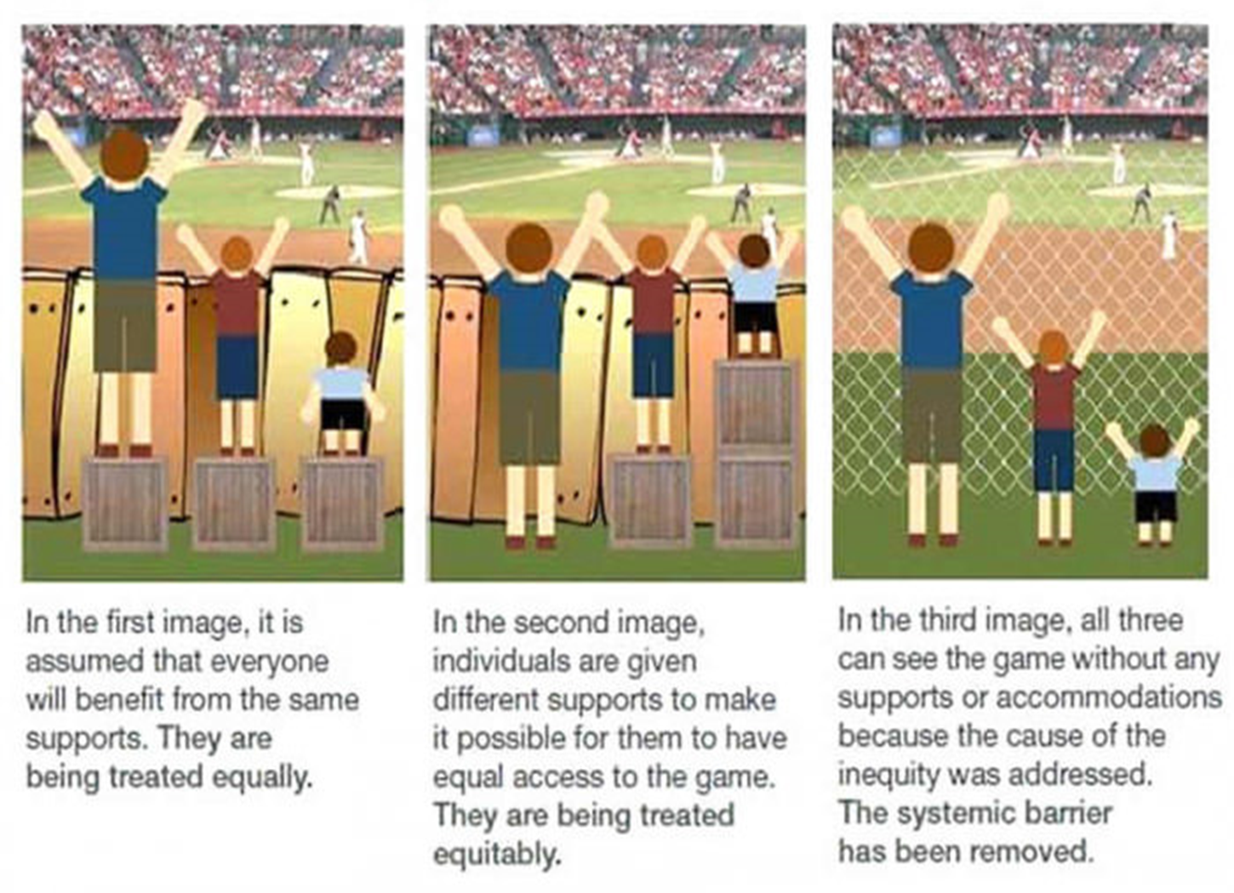
From equal treatment… to equitable treatment… to equitable structural and systemic change

Slide 6
b) What are some important, related concepts?
Inclusion
Diversity
Intersectionality
Targeted Universalism

Slide 7
Definitions of Diversity and Inclusion
DIVERSITY…
refers to the extent to which an organization or social setting includes broad representation of the individual and group differences in the population from which it draws its members or focuses its work.
INCLUSION… BELONGING…
involves creating a climate where people with different identities not only feel welcomed and valued but they co-create new systems/practices, so their presence is leveraged to produce better outcomes

Slide 8
Definition of Intersectionality
Intersectionality refers to the interconnected nature of social categorizations such as race/ethnicity, class, and gender as they apply to a given individual and is regarded as creating multiple dimensions of identity with overlapping and interdependent systems of preference/privilege or discrimination/disadvantage.
Social categorizations are both immutable (don’t change) and changeable (change with time or circumstances)
https://www.citelighter.com/sociology/sociology/knowledgecards/intersectionality-theory

Slide 9
Definition of Targeted Universalism
“Fairness is not advanced by treating those who are situated differently as if they were the same…A targeted universal strategy is one that is inclusive of the needs of both the dominant and marginal groups but pays particular attention to the situation of the marginal group.”
john a. powell, Post-Racialism or Targeted Universalism, 86 Denv. U. L. Rev. 785 (2008), Available at: http://scholarship.law.berkeley.edu/facpubs/1633

Slide 10
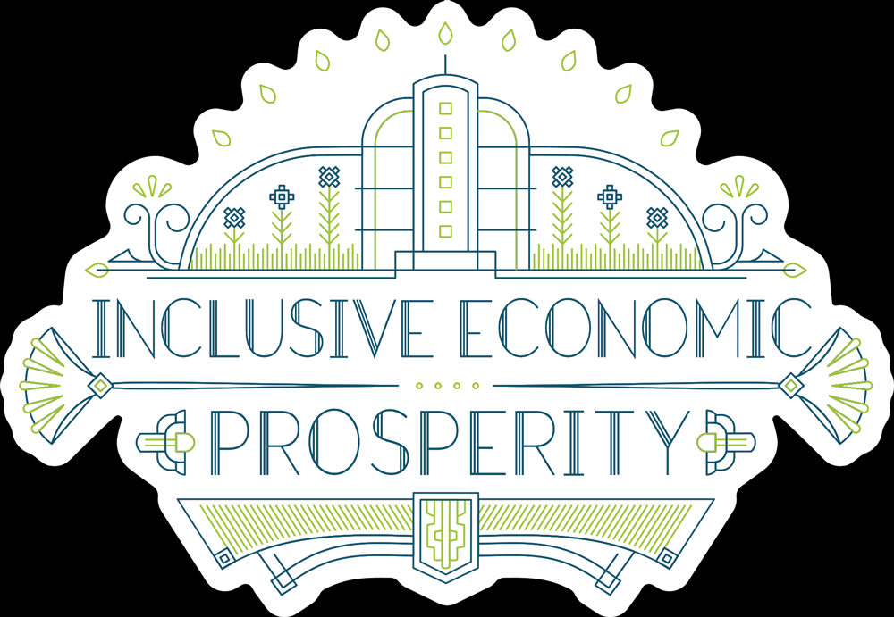
Why is Equity Important to the Nation?

Slide 11
Equity is an Existential Imperative for U.S.
INCLUSIVE ECONOMIC PROSPERITY
Worldwide, regional economies that are inclusive of their diverse populations perform better
NATIONAL SECURITY
Our conflicts in the U.S. over our diversity, exclusion and disparities is exploited by foreign enemies
HEALTH AND SAFETY
Domestic conflicts over our differences, especially racial/ethnic differences, are a source of toxic stress and violence for Whites as well as People of Color

Slide 12
Economic Benefits from Equity
Diversity Yields
Equity Dividends
Regional Economic Performance

Slide 13
Regional Economic Performance and Diversity Yields
REGIONAL ECONOMIC PERFORMANCE
Inclusive regions have been shown to have greater and longer economic growth periods, lower poverty levels, and more economic mobility. (Chicago Metropolitan Agency for Planning)
DIVERSITY YIELDS
Companies in the top quartile for ethnic and racial diversity on executive teams are 33% more likely to have industry-leading profitability. (U.S . Chamber of Commerce)
For every 10% increase in racial and ethnic diversity on a company’s senior executive team, earnings before interest and taxes rise 0.8%. (U.S . Chamber of Commerce)
Notes:
For example, the International Monetary Fund (IMF) has compared the growth periods3 of 140 countries and found a strong correlation between greater income equality and more sustained economic growth, as measured by changes in Gross Domestic Product (GDP) over time. 4 The Page 2 of 8 Inclusive Growth Approach chart below illustrates that the length of a country’s growth periods tends to be longer when there is less inequality. This finding reflects several earlier investigations on the relationship between inequality and growth.5For example, the Federal Reserve’s analysis of growth factors for 118 U.S. regions showed that a skilled workforce, ethnic diversity and minority businesses, racial inclusion, increased income equality, and less concentrations of poverty increase regional economic growth.7 T Metropolitan growth across the country was uneven after the 2008 recession, but regions that were more inclusive experienced more growth. A Brookings review of the nation’s 100 largest regions indicated that the 41 regions that experienced greater economic growth after the recession also had more racial inclusion, as measured by the difference for each group between median wages, relative income poverty by race, and employment by race.8 https://www.cmap.illinois.gov/documents/10180/534408/Inclusive+Growth+Approach+Memo_LUandED.pdf/79c37551-f44e-41fa-a349-c42eb25c0c06

Slide 14
Equity Dividend
If women received equal pay…
If people of color received equal pay…

Slide 15
Pay Differential by Gender in U.S.
IF women in the United States received equal pay with comparable men…
poverty for working women would be reduced by half; and
the U.S. economy would have added $512.6 billion in wage and salary income (equivalent to 2.8 percent of 2016 GDP) to its economy.

Slide 16
Income by race/ethnicity
How much would people of color gain with racial equity?
Mississippi: With racial equity in income in 2017, the average annual income would have been $34,020 for the Black population, an increase of $14,371 or 73%.

Slide 17
Why is Equity important in early childhood health and learning?

Slide 18
The Economics of Early Childhood Learning Investments
Expanding early learning initiatives would provide benefits to society of roughly $8.60 for every $1 spent*
Other investment returns include:
Increased Parental Earnings & Employment
Higher Educational Attainment and Decreased Racial/Economic Achievement Gaps
Higher Lifetime Earnings
Lower Remediation Costs
Reduced Criminal Justice System Involvement
*Source: The Economics of Early Childhood Investments

Slide 19
What are some tools/advice for discussing, developing and implementing Equity plans?

Slide 20
Principles for Advancing Equity in Collective Impact
Equity must be a universal collaborative and individual partner organization commitment.
There must be individual and organizational accountability for achieving equitable outcomes.
Equitable CI must engage people experiencing disparities and build their trust through transparent commitment and action to equity.
The collaborative must establish clear language about equity and the outcomes and measures for achieving equity; this language should be asset-based whenever possible.
Policies, practices and resources must be designed to identify and accommodate differences in the needs and experiences of various groups —not to treat all people or groups the same.
Achieving equity requires a continual process of disaggregating data, learning from the data and questioning/changing policies and practices associated with disparate outcomes.
Notes:
For example, the International Monetary Fund (IMF) has compared the growth periods3 of 140 countries and found a strong correlation between greater income equality and more sustained economic growth, as measured by changes in Gross Domestic Product (GDP) over time. 4 The Page 2 of 8 Inclusive Growth Approach chart below illustrates that the length of a country’s growth periods tends to be longer when there is less inequality. This finding reflects several earlier investigations on the relationship between inequality and growth.5For example, the Federal Reserve’s analysis of growth factors for 118 U.S. regions showed that a skilled workforce, ethnic diversity and minority businesses, racial inclusion, increased income equality, and less concentrations of poverty increase regional economic growth.7 T Metropolitan growth across the country was uneven after the 2008 recession, but regions that were more inclusive experienced more growth. A Brookings review of the nation’s 100 largest regions indicated that the 41 regions that experienced greater economic growth after the recession also had more racial inclusion, as measured by the difference for each group between median wages, relative income poverty by race, and employment by race.8 https://www.cmap.illinois.gov/documents/10180/534408/Inclusive+Growth+Approach+Memo_LUandED.pdf/79c37551-f44e-41fa-a349-c42eb25c0c06

Slide 21
Urban Strategies Council’s Equity Practices for Collective Impact
Define equity and educate the community on its importance.
Build data systems to support equity and effectively use data.
Establish explicit equity outcomes and accountability for achieving them.
Engage the community and ensure leadership is representative of the community.
Focus on increasing equity and improving outcomes.
Apply targeted universalism.
Continually assess for and address equity.
Hold systems accountable for reducing and eliminating disparities.
Notes:
For example, the International Monetary Fund (IMF) has compared the growth periods3 of 140 countries and found a strong correlation between greater income equality and more sustained economic growth, as measured by changes in Gross Domestic Product (GDP) over time. 4 The Page 2 of 8 Inclusive Growth Approach chart below illustrates that the length of a country’s growth periods tends to be longer when there is less inequality. This finding reflects several earlier investigations on the relationship between inequality and growth.5For example, the Federal Reserve’s analysis of growth factors for 118 U.S. regions showed that a skilled workforce, ethnic diversity and minority businesses, racial inclusion, increased income equality, and less concentrations of poverty increase regional economic growth.7 T Metropolitan growth across the country was uneven after the 2008 recession, but regions that were more inclusive experienced more growth. A Brookings review of the nation’s 100 largest regions indicated that the 41 regions that experienced greater economic growth after the recession also had more racial inclusion, as measured by the difference for each group between median wages, relative income poverty by race, and employment by race.8 https://www.cmap.illinois.gov/documents/10180/534408/Inclusive+Growth+Approach+Memo_LUandED.pdf/79c37551-f44e-41fa-a349-c42eb25c0c06

Slide 22
What are some resources for exploring Equity further?

Slide 23
Resources on Equity In Collective Impact
Collective Impact Forum
Bringing an Equity Lens to Collective Impact
Three Steps for Advancing Racial Equity through Collective Impact
Equity: The Soul of Collective Impact
Equity in Collective Impact: 3-part series in SSIR from FSG, Aspen, and PolicyLink
When Collective Impact Has an Impact,: this longer report includes a section on implementing collective impact with an equity approach.
Table A3 in the appendix has an “equity rubric” that might be of interest.
For additional equity resources, go to this Equity Resources page from the Collective Impact Forum website.
Notes:
For example, the International Monetary Fund (IMF) has compared the growth periods3 of 140 countries and found a strong correlation between greater income equality and more sustained economic growth, as measured by changes in Gross Domestic Product (GDP) over time. 4 The Page 2 of 8 Inclusive Growth Approach chart below illustrates that the length of a country’s growth periods tends to be longer when there is less inequality. This finding reflects several earlier investigations on the relationship between inequality and growth.5For example, the Federal Reserve’s analysis of growth factors for 118 U.S. regions showed that a skilled workforce, ethnic diversity and minority businesses, racial inclusion, increased income equality, and less concentrations of poverty increase regional economic growth.7 T Metropolitan growth across the country was uneven after the 2008 recession, but regions that were more inclusive experienced more growth. A Brookings review of the nation’s 100 largest regions indicated that the 41 regions that experienced greater economic growth after the recession also had more racial inclusion, as measured by the difference for each group between median wages, relative income poverty by race, and employment by race.8 https://www.cmap.illinois.gov/documents/10180/534408/Inclusive+Growth+Approach+Memo_LUandED.pdf/79c37551-f44e-41fa-a349-c42eb25c0c06

Slide 24
Junious Williams, JD Senior Advisor, Collective Impact Forum collectiveimpactforum.org Principal, Junious Williams Consulting, Inc. . www.juniouswilliams.com juniouswilliamsjr@gmail.com 510.213.3438

Slide 25
Income by race/ethnicity
How much would people of color gain with racial equity?
United States: With racial equity in income in 2017, the average annual income would have been $43,987 for the Black population, an increase of $17,137 or 64%.

